Slide 2
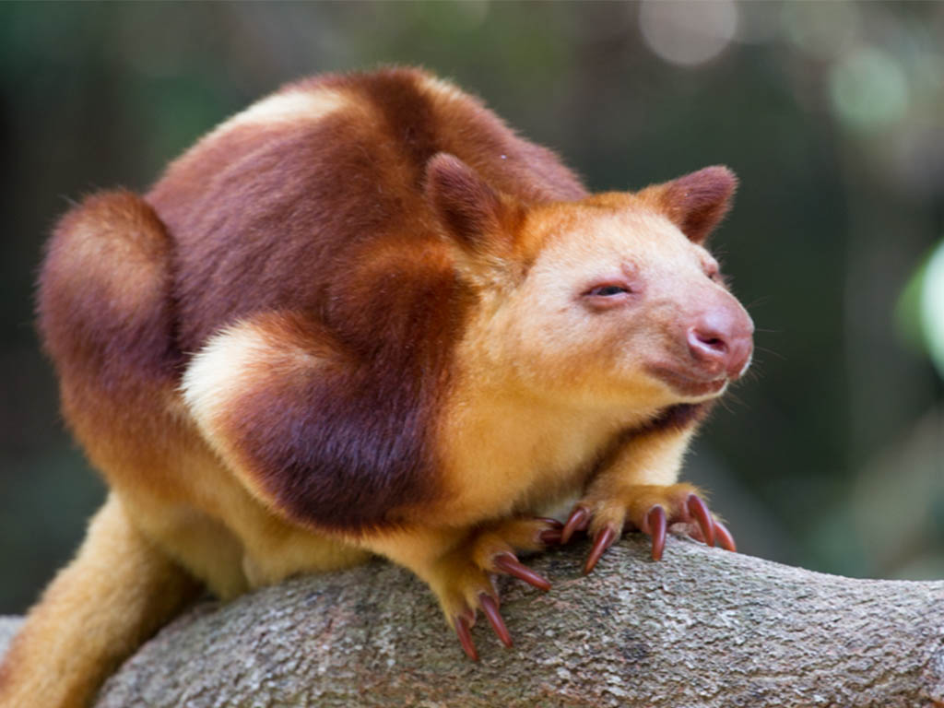
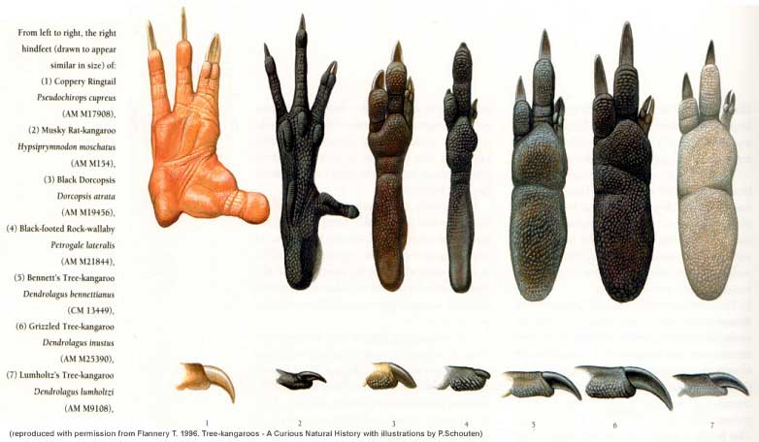
Macropodiforms: Macropodidae Kangaroos, tree-kangaroos, and wallabies

Slide 3
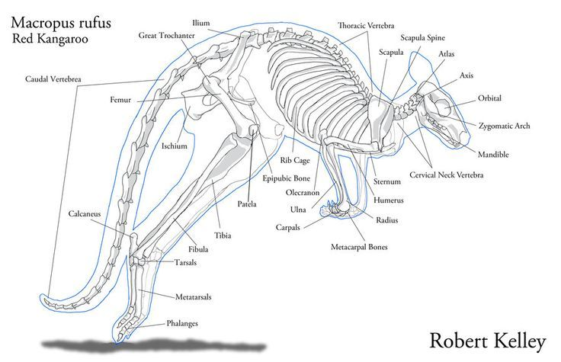

Slide 4
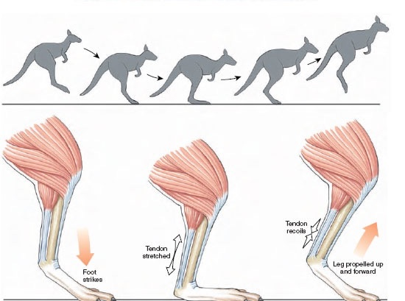

Slide 5
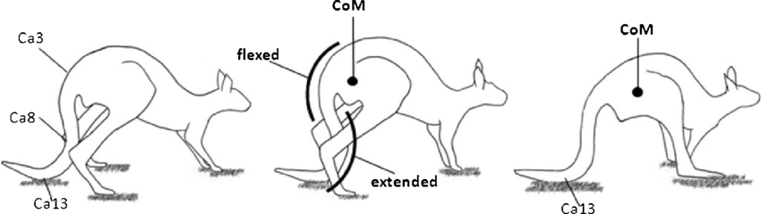
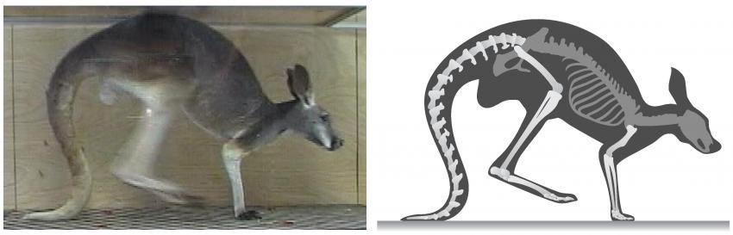
Pentapedal locomotion

Slide 6
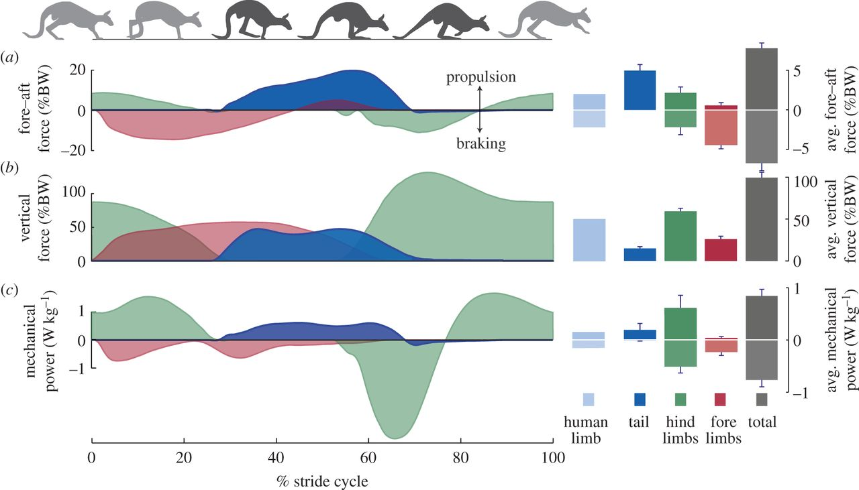
Notes:
https://royalsocietypublishing.org/doi/10.1098/rsbl.2014.0381

Slide 7
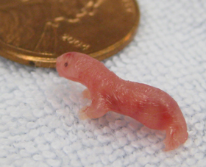
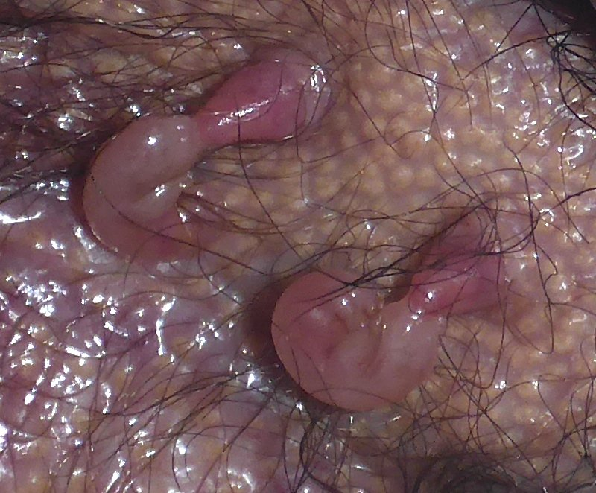
Marsupial Reproduction

Slide 8
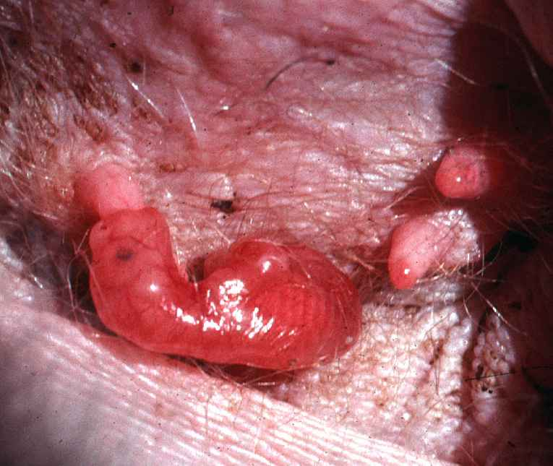
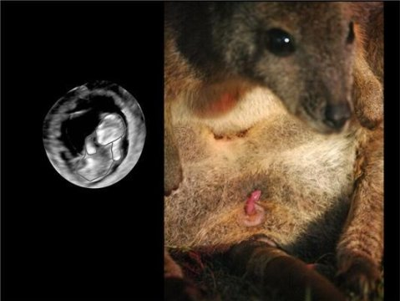
Marsupial Reproduction

Slide 9
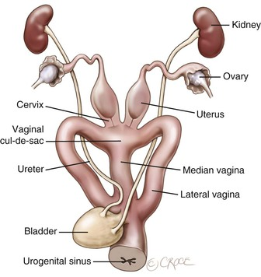
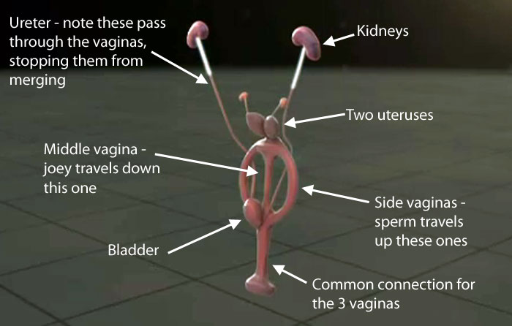

Slide 10
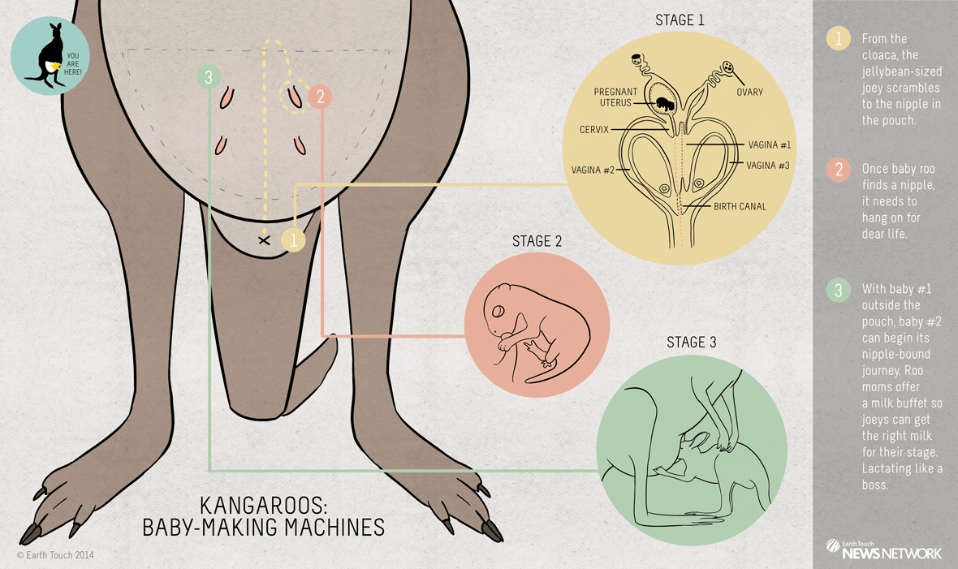

Slide 11
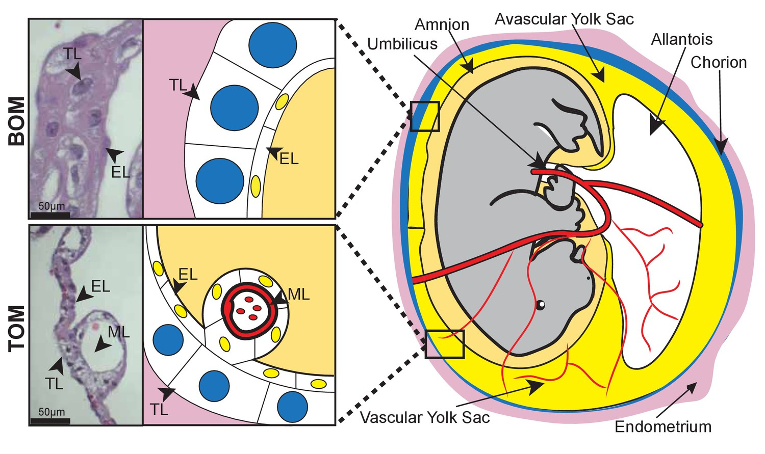
Placenta made of chorion & vitelline vessels

Slide 12
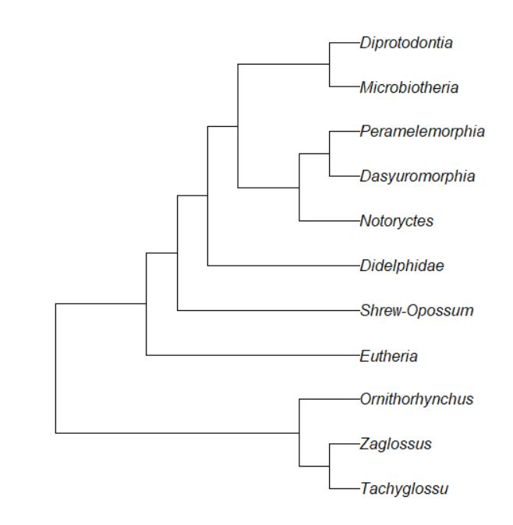

Slide 13
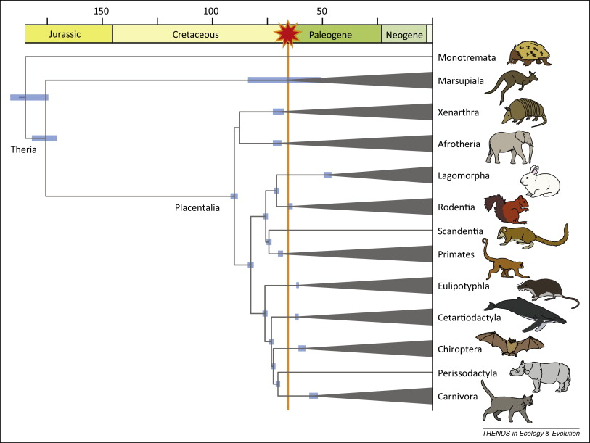
Eutheria
Euarchontoglires
Laurasiatheria

Slide 14
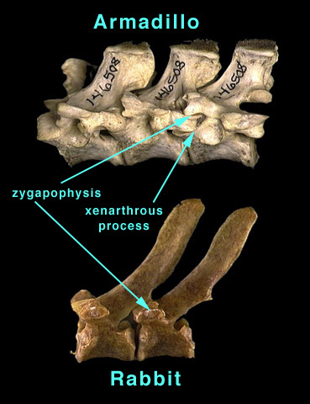
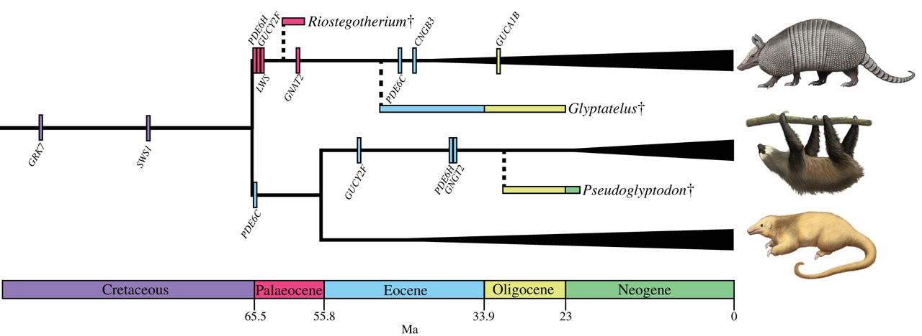
Xenarthra
No enamel!
Armadillos: South & North America
Pilosa
Sloths: South & Central America (6 sp)
Anteaters: South America (4 sp)

Slide 15
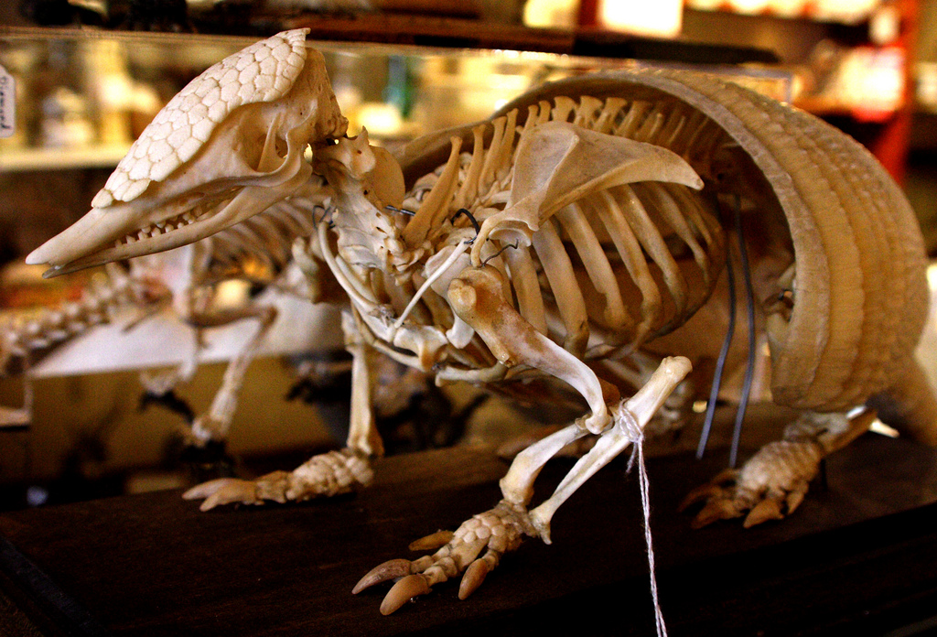
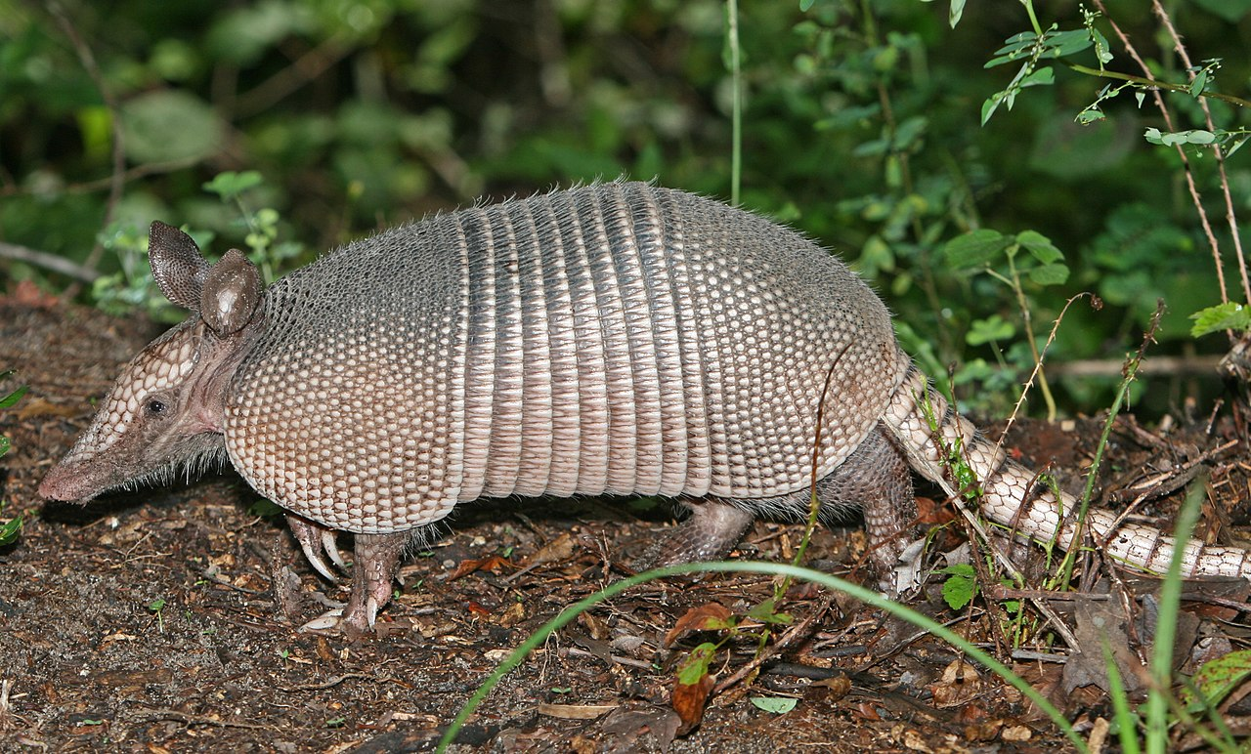
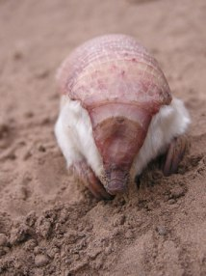
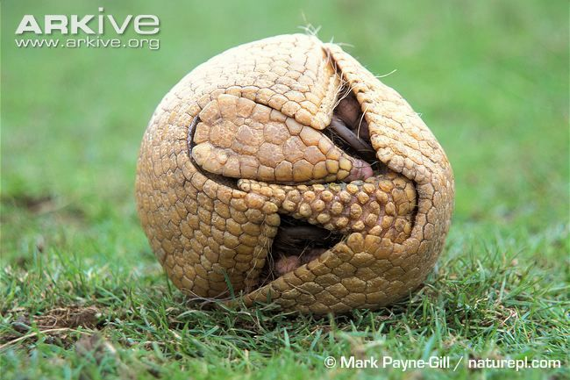
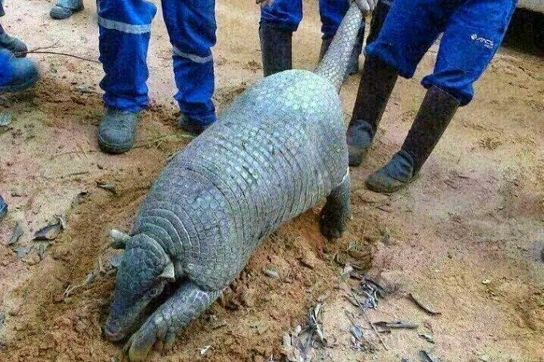
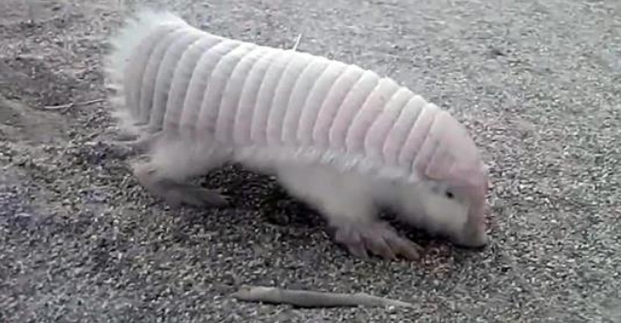
Xenarthra: Armadillos (21 sp)

Slide 16
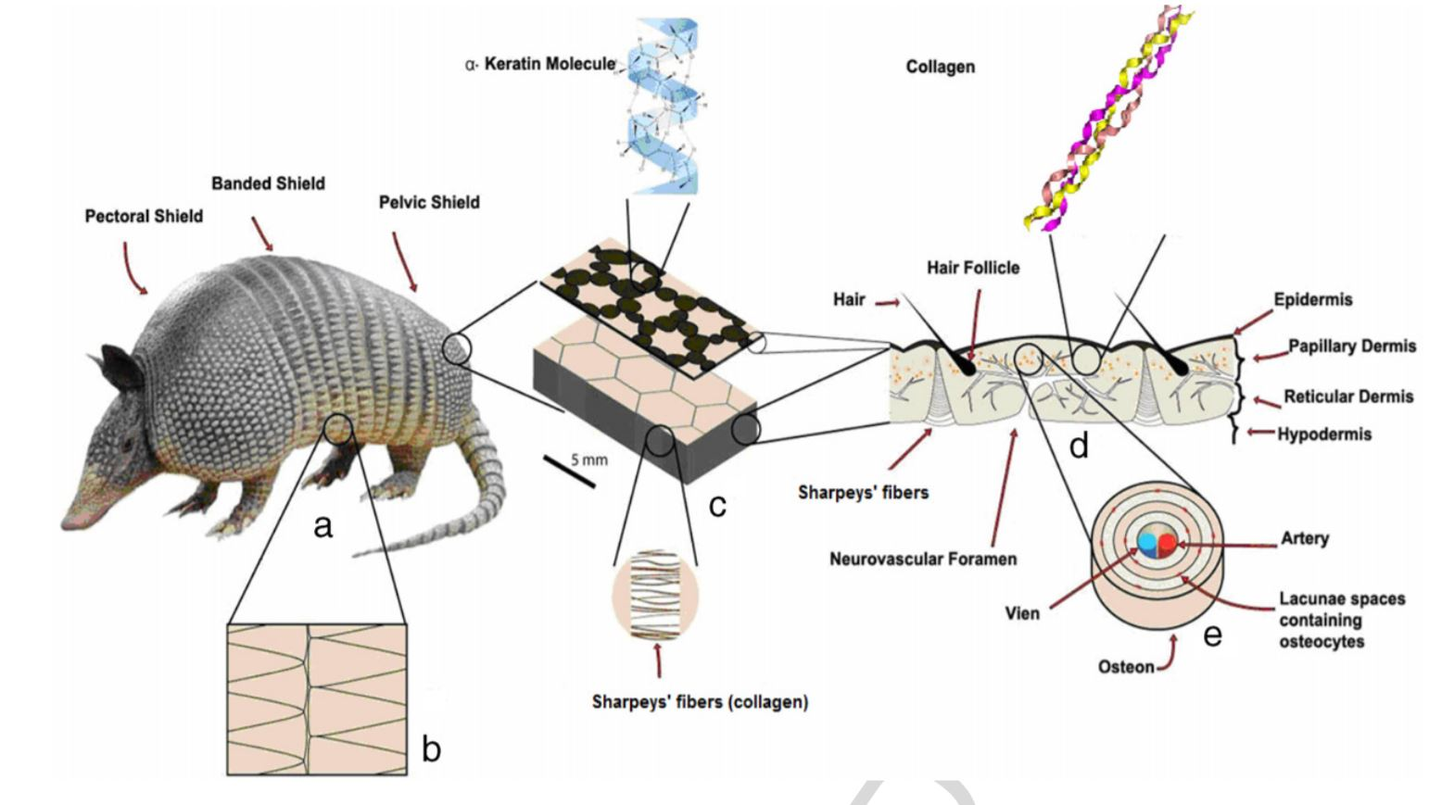
Xenarthra: Armadillos (21 sp)

Slide 17
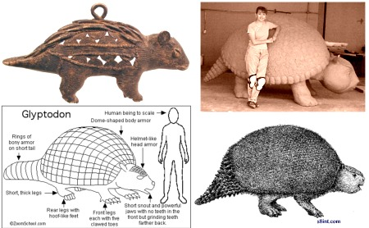
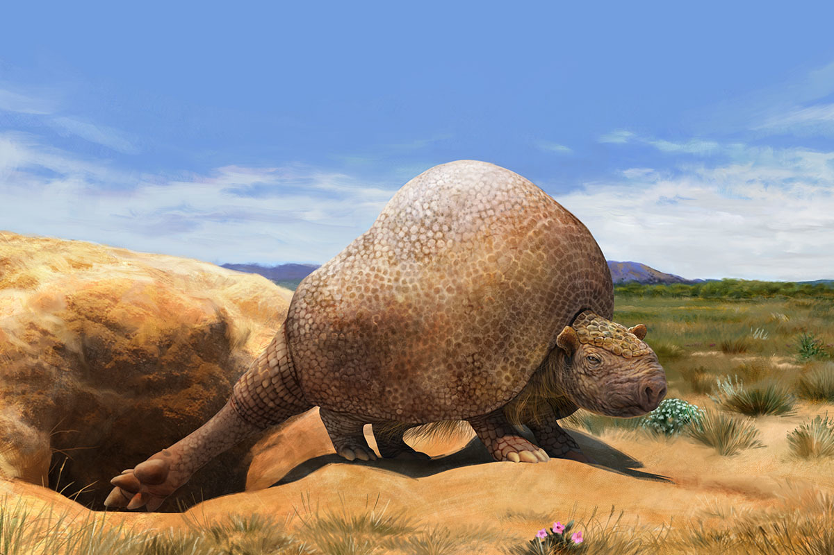
Xenarthra: Armadillos (21 sp)

Slide 18
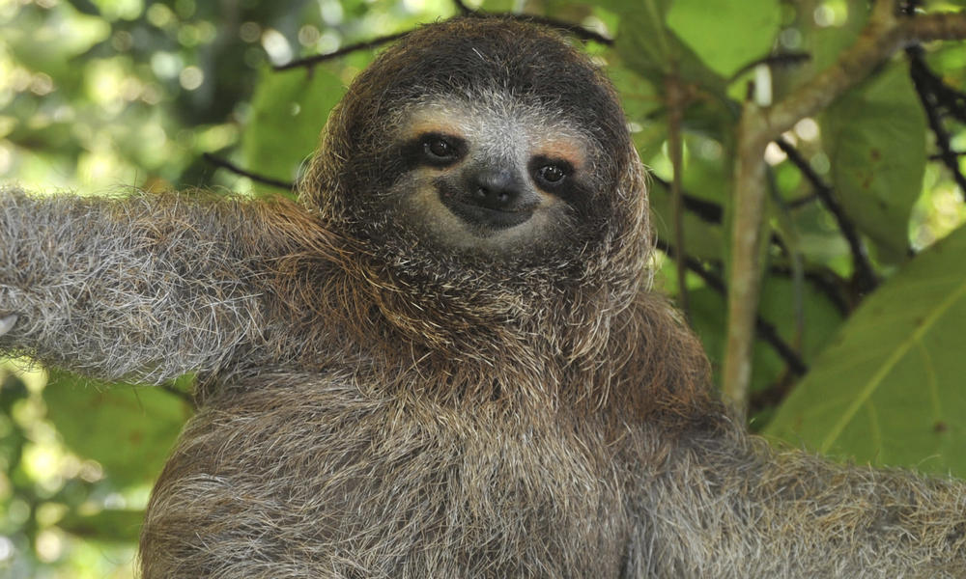
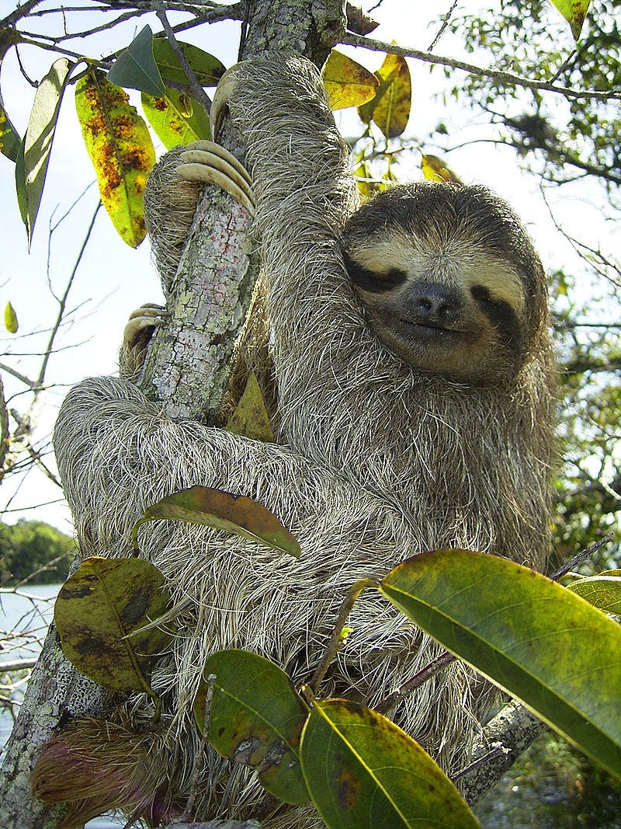
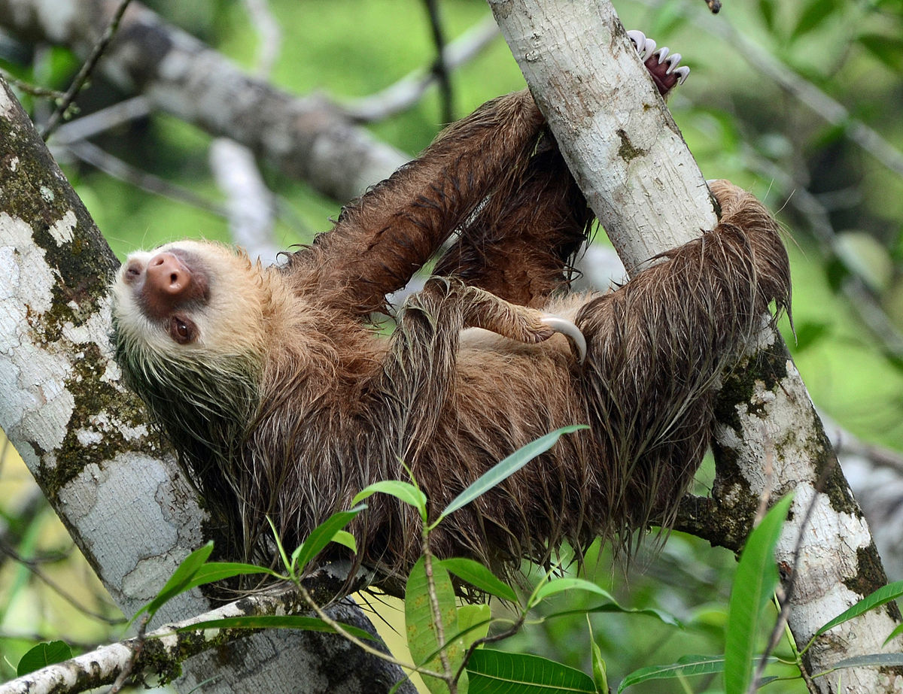
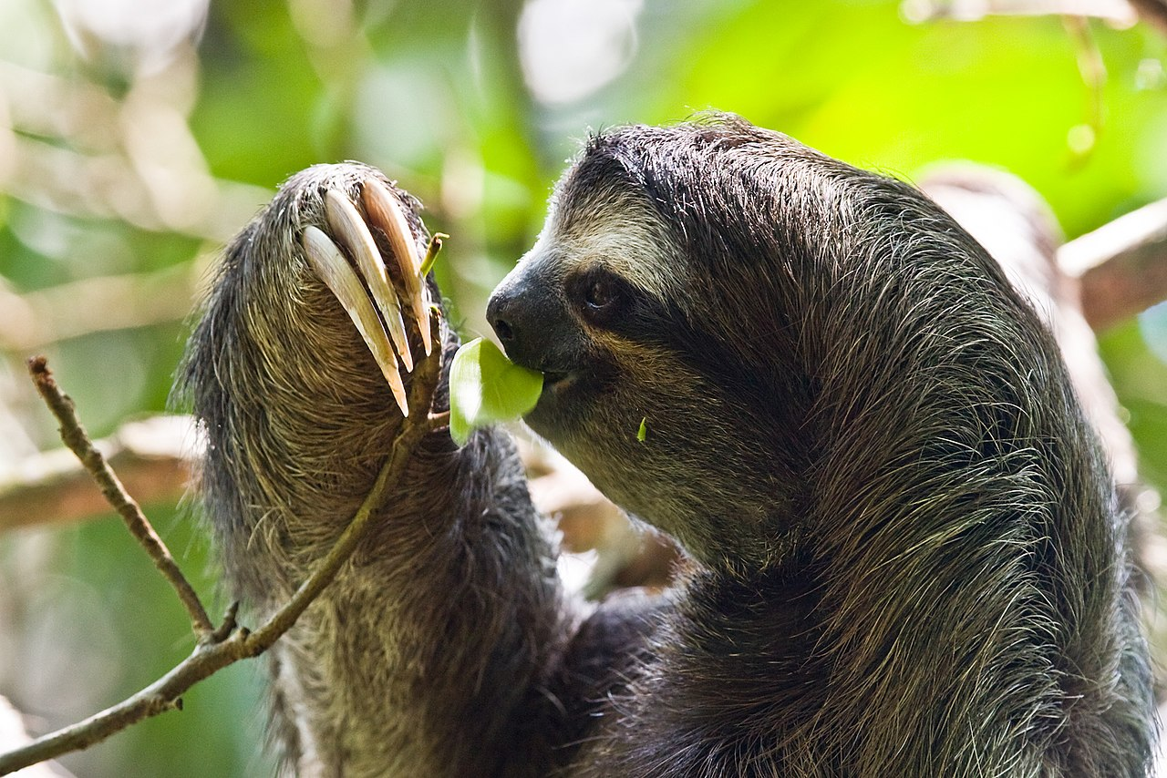
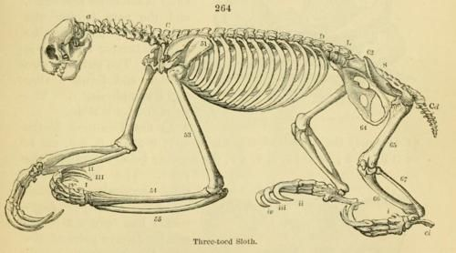
Xenarthra: Pilosa: Folivora (Sloths, 6 species)
Notes:
Giant sloths, algae, digestive system, teeth

Slide 19
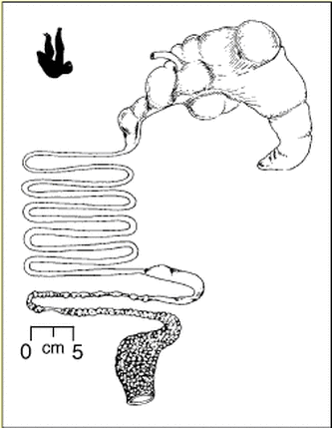
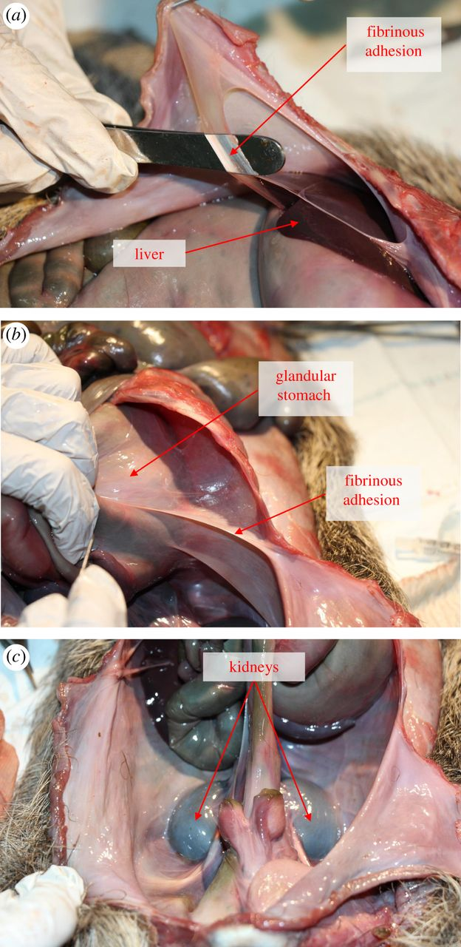
Xenarthra: Pilosa: Folivora (Sloths, 6 species)
Notes:
A third of their weight in waste, as they only defecate once a week. Sloths take between 150 and 1200 hours to pass a meal. Stomach fermentation. Highly variable body temperature, almost cold-blooded

Slide 20
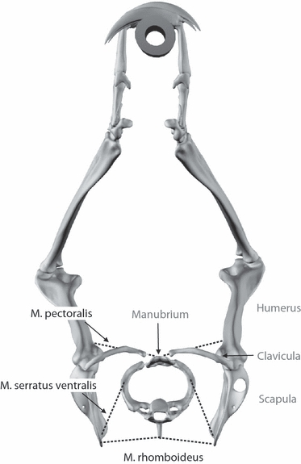
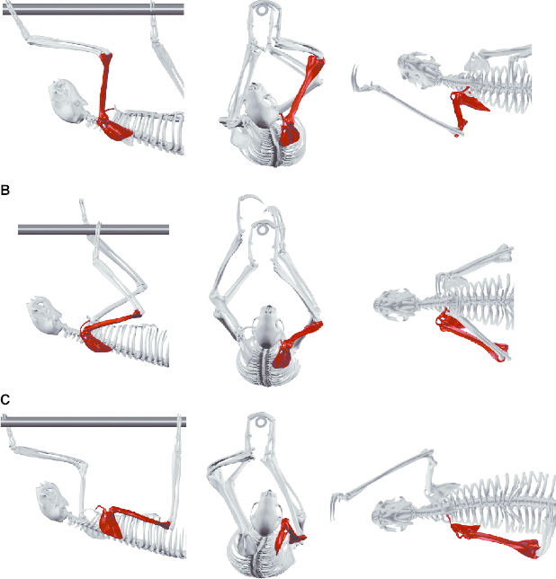
Notes:
Giant sloths, algae, digestive system, teeth

Slide 21
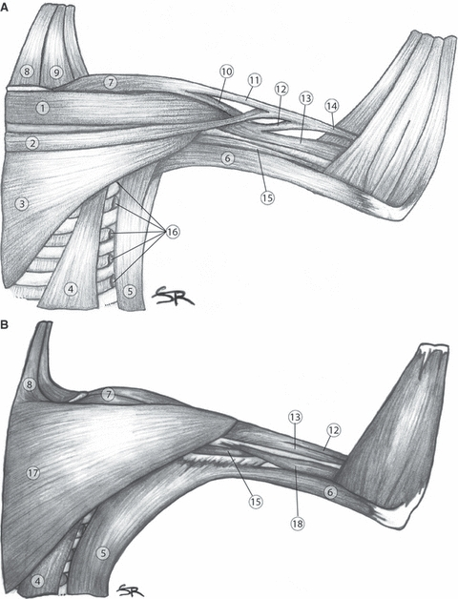
Folivora
Notes:
Superficial muscles of the shoulder region of Choloepus didactylus (A) and Bradypus variegatus (B). Ventral aspect. 1: M. pectoralis superficialis anterior; 2: M. pectoralis superficialis posterior; 3: M. pectoralis profundus medius; 4: M. pectoralis profundus posterior; 5: M. latissimus dorsi; 6: M. dorso-epitrochlearis; 7: M. deltoideus; 8: M. sternomastoideus; 9: M. cleidomastoideus; 10: M. deltoideus pars clavicularis; 11: M. deltoideus pars acromialis; 12: M. biceps brachii anterior belly; 13: M. biceps brachii caudal belly; 14: Common tendon of 2, 11, 12; 15: M. coracobrachialis; 16: M. serratus ventralis; 17: M. pectoralis superficialis; 18: M. triceps brachii caput mediale. sloths, algae, digestive system, teeth

Slide 22
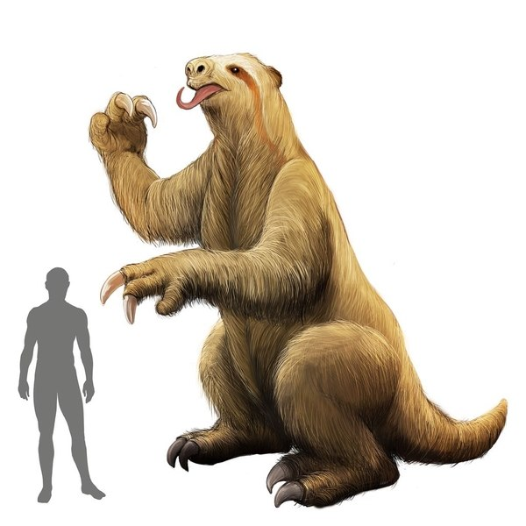
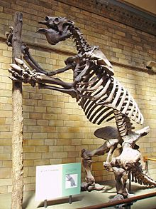
Ground sloths

Slide 23
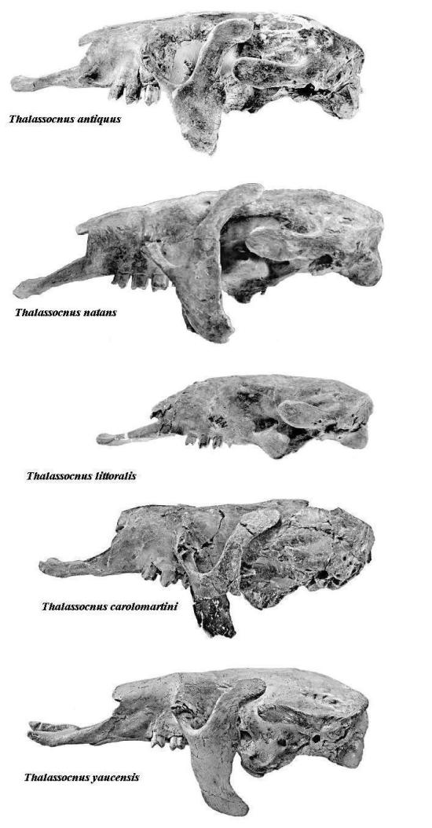
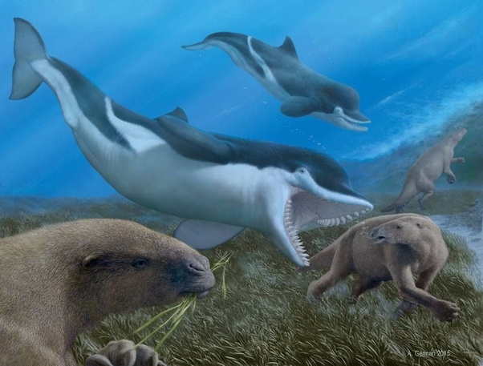
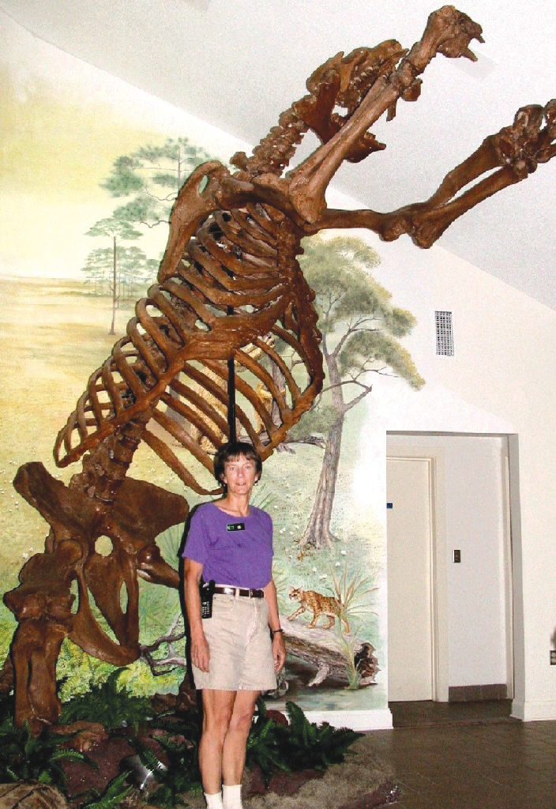
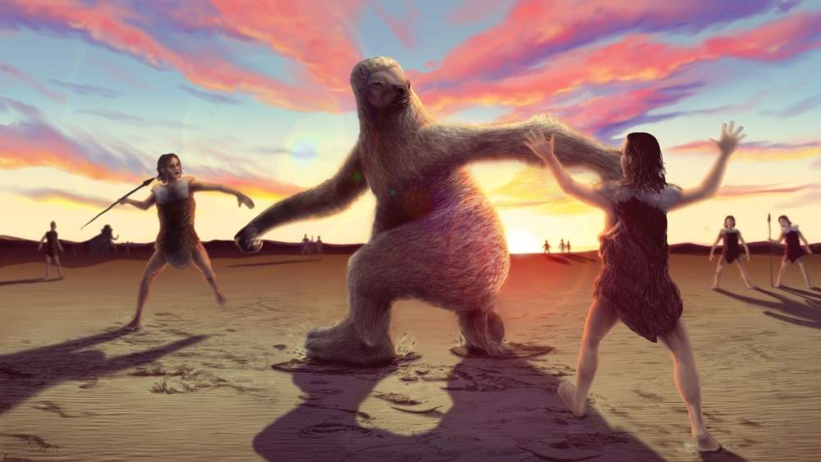
Extinct sloths! Giant! Marine!
Notes:
Giant sloths, algae, digestive system, teeth

Slide 24
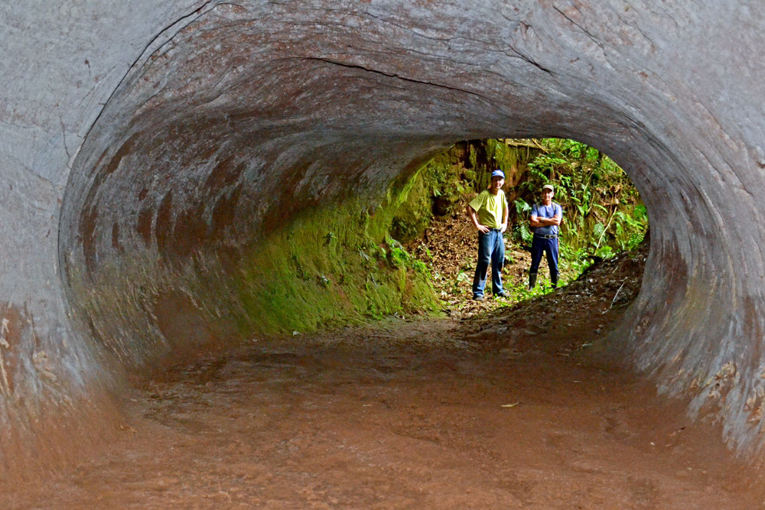
Extinct sloths! Giant! Marine!
Notes:
Giant sloths, algae, digestive system, teeth

Slide 25
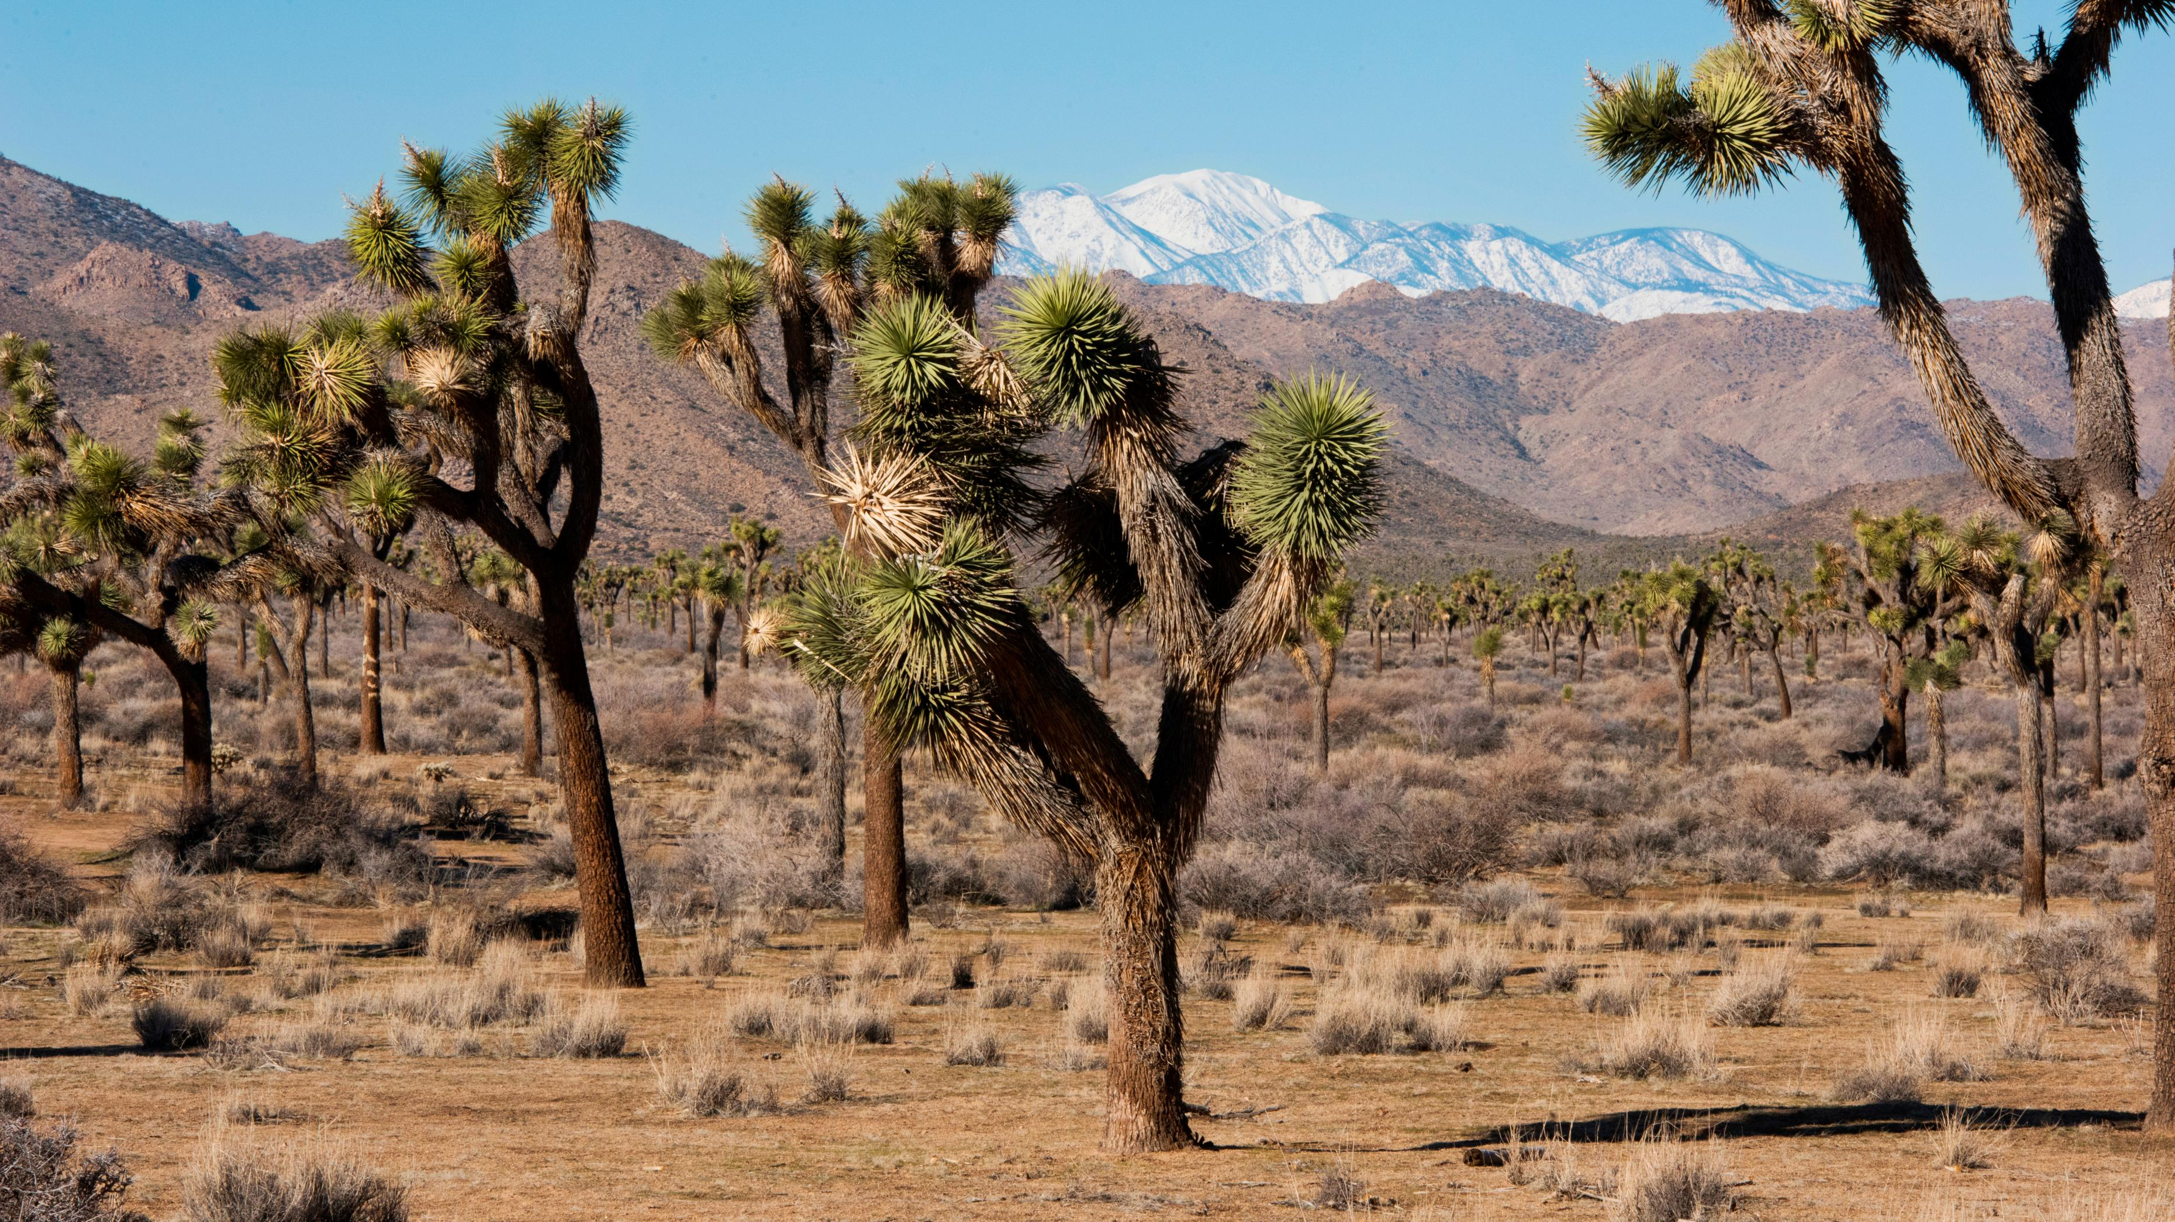
Ecological ghosts
Notes:
Giant sloths, algae, digestive system, teeth

Slide 26
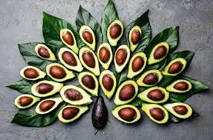
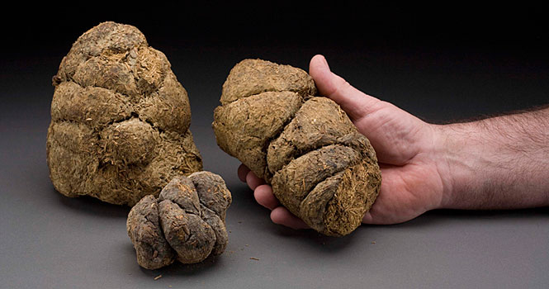
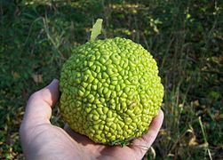
Ecological ghosts
Notes:
Giant sloths, algae, digestive system, teeth

Slide 27
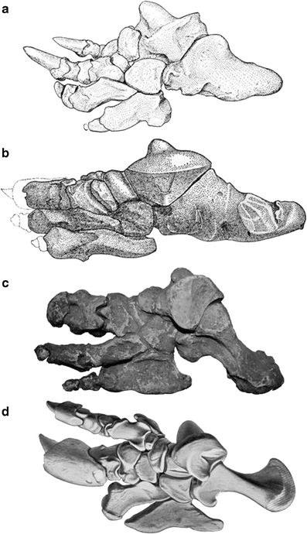


Ground sloth ankles

